Slide 1
Software Engineering: Analysis and Design
Software Metrics

Slide 2
Lecture Outline
Definitions
What should we measure?
Measuring Size
  Lines of Code
Measuring Functionality
  Function Points
Software Cost Estimation

Slide 3
What is a Software Metric?
A metric is a measurement of some aspect of the software product or the software process
We take metrics for a variety of reasons
  to measure the quality of a product
  to assess the productivity of the people building the product
  to assess the benefits (productivity and quality) of new software tools
  to form a baseline so we can estimate for new tools
  to help justify requests for new tools or additional training

Slide 4
The Need For Software Metrics
Software Development in general
  has excessive costs (especially in maintenance)
  low productivity
  poor quality
  lack of standards
Reasons being that we fail to:
  set measurable targets
  measure the real costs in projects
  quantify the quality
  properly evaluate new tools and techniques

Slide 5
Parameters - Estimate Cost
Estimating the cost of the project
Set the bottom line of the project
Depends on people cost, external services cost
Inputs
  People cost
  Other resources cost
    Hardware, Software, Tools
  Infrastructure cost
    Communication link
  Other costs
    Travel
    Visa etc.
  Cost of risk
Cost
Schedule
Efforts
Size
Software
Project

Slide 6
Types of Metrics
Productivity Metrics
  focus on the output of the software engineering process
Quality Metrics
  focus on the conformance of the software to the implicit and explicit user requirements (fitness for use)
Technical Metrics
  focus on the character of the software, e.g. coupling and cohesion
Size-oriented Metrics
  direct measures of the output and quality of the SE process
Function-oriented Metrics
  indirect measures of the output and quality of the SE process
Human-oriented Metrics
  information about the method by which people build and use systems

Slide 7
External versus Internal Metrics
We want to be able to measure external aspects like:
  Maintainability
  Reliability
  Portability
  Useability
These things are very difficult to measure directly
So we develop internal measures which are theoretically correlated with the aspect of the software which we wish to measure

Slide 8
Internal Metrics
To be a valid measure of an external aspect:
  the internal metric must be measured accurately
  there must be a relationship between what we can measure and the external behavioural attribute
  the relationship must be understood, have been validated and be expressed in terms of a formula or a model
An example
  McCabe’s cyclomatic complexity measure (measure the internal complexity of a line of code)
  Said to be related to the maintainability of a component
  Reasonable to assume that maintainability is related to the overall complexity of a component
  But cannot assume that cyclomatic complexity is the only measure of overall complexity or even the dominant factor in the overall complexity

Slide 9
Cost Estimation Process
product specs
Size
Estimation
Cost
Estimation
software costs
software size
size drivers
development time
product attributes
platform attributes
phase distribution
personnel attributes
project attributes
activity distribution
development methods

Slide 10
Software Cost Estimation
Any project has the following goals with regard to costs:
  to establish a budget
  to have a means of controlling project costs
  to monitor progress against that budget by comparing planned and estimated cost
  to develop a cost database for future estimation
  to ascertain costs for the planning and scheduling function
This means we need metrics which let us estimate how much a project is going to cost prior to completing the project
The sooner, the better!

Slide 11
Software Cost Estimation Methods
Algorithmic - mathematical algorithms which produce a cost estimate based upon variables (e.g. COCOMO and COCOMO II)
  (see http://sunset.usc.edu/research/COCOMOII/)
Expert Judgement - individual or group assessment of cost based upon past experience
Estimation by Analogy - comparing with completed projects
Parkinsonian - Work expands to fill the available volume, The project costs whatever resources are available
Price-to-Win - Cost estimated based upon what the customer will pay
Notes:
Following Pressman:
COCOMO = Constructive Cost Model (Barry Boehm 1981) COCOMO II dates from 1996-2000. A hierarchy of estimation models that address:
- Application composition model: used during the early stages of software engineering, when prototyping of user interfaces, considerations of software and system interaction, assessment of performance, and evaluation of technology maturity are paramount.
- Early design stage model: used once requirements have been stabilized and basic software architecture has been established
- Post architecture stage model: used during the construction of the software
Needs sizing information. Three options: object points, function points and LOC

Slide 12
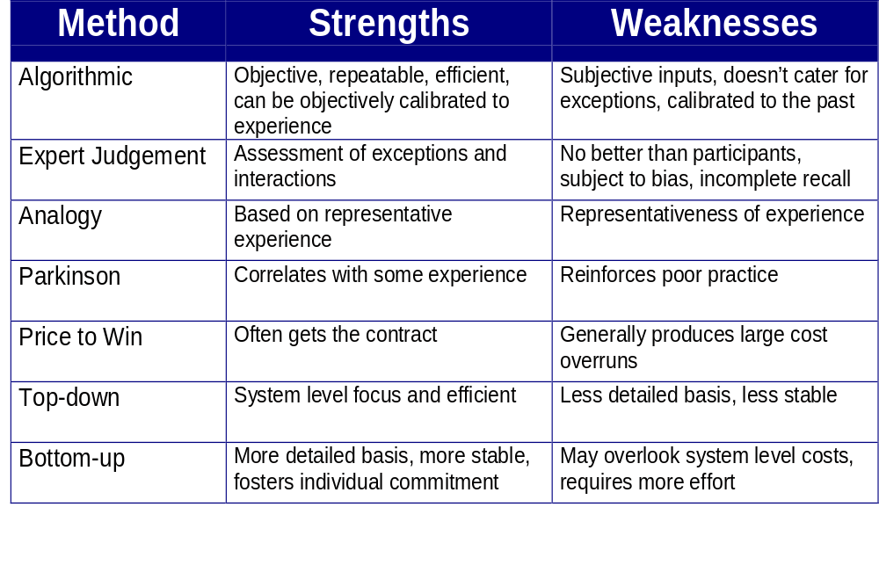
Strengths and Weaknesses
No one method is sufficient; recommend top-down expert judgement and analogy combined with bottom-up algorithmic estimation

Slide 13
Approaches to Cost Estimation
Top-down estimation
  create an overall cost and then split the cost amongst the components
  Analogy, Parkinsonian and price-to-win are examples of top-down estimating
Bottom-up estimation
  Cost of each individual component is estimated by an individual (usually the person who has to build the component)
  Costs for all the components are summed

Slide 14
Size-oriented metrics
Built on the past experiences of organisations
Direct measures of the software
Primary Examples
  Size of a product = Kilo Lines of Code (KLOC)
  Productivity = KLOC/person-month
  Person-month: time(in months) taken by developers to finish the product.
  Quality = number of faults/KLOC
  Defects stand for Total Number of errors discovered
  Cost = $/KLOC
  Documentation = pages of documentation/KLOC
Generally based on the idea of a Line of Code or Source Line of Code

Slide 15
Lines of Code
A controversial measure
Defined as one line of text in a source file
Modified by a number of factors depending upon your Source Line of Code (SLOC) Counting Standard
Simplest Standard
  Don’t count blank lines
  Don’t count comments
  Count everything else

Slide 16
A More Complex LOC Standard for C++
Is a logical SLOC standard as opposed to a physical SLOC standard
Divides each line up based upon the number of logical statements within each line
Tries to provide a more accurate measure of the complexity of a line
Need to do this if the assumption that the proportion of complex lines to simple lines is stable

Slide 17
Advantages and Disadvantages
Advantages
  Artifact of software development which is easily counted
  Many existing methods use LOC as a key input
  A large body of literature and data based on LOC already exists
Disadvantages
  Programming language-dependent
  Does not easily accommodate non-procedural languages
  Reuse can be difficult to factor in
  Difficult to develop a figure for LOC early in the development

Slide 18
COCOMO
It is a l software cost estimation model. Basic COCOMO computer software development effort (and cost) as a function of program size. COCOMO applies to three classes of software projects:
Organic projects - "small" teams with "good" experience working with "less than rigid" requirements
Semi-detached projects - "medium" teams with mixed experience working with a mix of rigid and less than rigid requirements
Embedded projects - developed within a set of "tight" constraints. It is also combination of organic and semi-detached projects.(hardware, software, operational, ...)

Slide 19
Organic
  In the organic mode, relatively small software teams develop software in a highly familiar, in-house environment. Most people connected with the project have extensive experience in working with related systems within the organization, and have a thorough understanding of how the system under development will contribute to the organizations objectives. Very few organic-mode projects have developed products with more than 50 thousand delivered source instructions (KDSI).

Slide 20
Embedded
  The major distinguishing factor of an embedded-mode software project is a need to operate within tight constraints. The product must operate within (is embedded in) a strongly coupled complex of hardware, software, regulations, and operational procedures, such as an electronic funds transfer system or an air traffic control system.

Slide 21
Semidetached
  The semidetached mode of software development represents an intermediate stage between the organic and embedded modes. "Intermediate" may mean either of two things:
    An intermediate level of project characteristic.
    A mixture of the organic and embedded mode characteristics.
  The size range of a semidetached mode product generally extends up to 300 KDSI.

Slide 22
Basic COCOMO
Computes software development effort (and cost) as a function of program size, expressed in estimated lines of code.

Slide 23
The basic COCOMO equations take the form
Effort Applied (E) = a_{b}(KLOC)^{b}_{b} [ man-months ]
Development Time (D) = c_{b}(Effort Applied)^{d}_{b} [months]
People required (P) = Effort Applied / Development Time [count]
where, KLOC is the estimated number of delivered lines (expressed in thousands ) of code for project. The coefficients a_{b}, b_{b}, c_{b} and d_{b} are given in the following
table:
Software
project
a_{b}
b_{b}
c_{b}
d_{b}
Organic
2.4
1.05
2.5
0.38
Semi-
detached
3.0
1.12
2.5
0.35
Embedded
3.6
1.20
2.5
0.32

Slide 24
Function-oriented Metrics
Concentrate on measuring the functionality of a system
Are generally independent of the programming language used
The first and by far the most popular is the FUNCTION POINT
Developed by Albrecht in 1979 for IBM
Function points are derived using
  countable measures of the software requirements domain
  assessments of the software complexity

Slide 25
Function‐oriented metrics uses a measure called the function point.
Function points are derived using an empirical relationship based on countable (direct) measures of software's information domain and assessments of software complexity.
Five information domain characteristics as listed below are determined and counts are provided:

Slide 26
Calculating Function Points
Number of user inputs
  each user input which provides distinct application data to the software is counted
Number of user outputs
  each user output that provides application data to the user is counted, e.g. screens, reports, error messages
Number of user inquiries
  An on-line input that results in the generation of some immediate software response in the form of an output
Number of files
  each logical master file, i.e. a logical grouping of data that may be part of a database or a separate file
Number of external interfaces
  all machine-readable interfaces that are used to transmit information to another system are counted

Slide 27
Calculating Function Points (2)
Weighting Factor
Measurement parameter Count Simple Average Complex Total
Number of user Inputs x3 x4 x6 =
Number of user outputs x4 x5 x7 =
Number of user Inquiries x3 x4 x6 =
Number of files x7 x10 x15 =
Number of external interfaces x5 x7 x10 =
Count total

Slide 28
Calculating Function Points (3)
Once the data is collected, a complexity value is associated with each count
The organisation needs to develop criteria which determine whether a particular entry is simple, average or complex
The weighting factors should be determined empirically
Albrecht has not revealed his data for the standard weighting factors

Slide 29
Calculating Function Points (4)
We now assess the software complexity
Rate each of the factors on the next slide according to the following scale:
  0 - No influence
  1 - Incidental
  2 - Moderate
  3 - Average
  4 - Significant
  5 - Essential

Slide 30
Complexity Questions
Does the system require reliable backup and recovery?
Are data communications required?
Are there distributed processing functions?
Is performance critical?
Will the system run in an existing, heavily utilised operational environment?
Does the system require on-line data entry?
Does the on-line data entry require the input transaction to be built over multiple screens or operations?
Are the master files updated on-line?
Are the inputs, outputs, files or inquiries complex?
Is the internal processing complex?
Is the code designed to be reusable?
Are conversion and installation included in the design?
Is the system designed for multiple installations in different organisations?
Is the application designed to facilitate change and ease of use by the user?

Slide 31
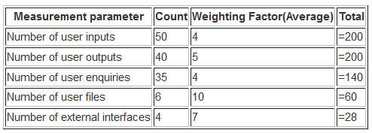
Calculating a Number
Function point = FP = UPF x VAF
UFP = Sum of all the complexities i.e. the 5 parameters ,
VAF = Value added Factor i.e. 0.65 + (0.01 * TDI),
TDI = Total Degree of Influence of the 14 General System Characteristics.

Slide 32

AVERAGE characteristic weight = 3
= (200 + 200 + 140 + 60 + 28) x (0.65 + (.01 x (14 x 3))
= 628 x (0.65 + 0.42)
= 628 x (1.07)
= 672

Slide 33
Function Points (FP) =
count-total x [0.65 + (0.01 x Sum(F_{i})]
where F_{i} are the 14 complexity adjustment values

Slide 34
Advantages and Disadvantages
Advantages
  Programming language-independent
  Based on data which are known early in the project
  Significant bodies of data available
Disadvantages
  developed for business systems and therefore only valid for that domain (the use of Feature Points, which extend Function Points by also counting algorithms, solves this to some extent)
    (see http://www.spr.com/products/feature.htm)
  Many aspects are subjective and have not been validated
  Function Points have no physical meaning, it’s just a number

Slide 35
Small project: < 2000 Function Points
Medium Project: 2,000 to 10,000 Function Points
Large Project:: > 10,000 Function Points

Slide 36
References
Pressman, Roger S., Software Engineering: A Practitioner’s Approach, McGraw-Hill, 2000 (Chs. 4, 5).

